Slide 1

KAVIKULGURU INSTITUTE OF TECHNOLOGY AND SCIENCE, RAMTEK
DEPARTMENT OF INFORMATION TECHNOLOGY
Multi Indicator for Stock Market Prediction using KNN
GROUP NO. 13
presented by:-
Kartik Anil Thakre (IT20011)
Samiksha Dilip Wanjari (IT20025)
Rahul Mahesh Salame (IT20001)
Manish Ganesh Golhar (IT20020)
Rohit Kashti (ITD20086)
Project Supervisor :
Mr. Sachin Meshram
Assistant professor

Slide 2
CONTENTS
Introduction
Abstract
Indicator
Literature Survey
Architecture
Drawbacks of Existing System
Approach
Proposed work
Application of Proposed System
9. References

Slide 3
INTRODUCTION
In stock market analysis, various indicators are used to help traders and investors make informed decisions about buying, selling, or holding stocks. These indicators are mathematical calculations based on historical price and volume data and are used to identify trends, momentum, volatility, and potential entry or exit points. Here's a short summary of some commonly used indicators
Machine learning techniques are being applied to stock market analysis. These algorithms can analyze vast amounts of data, identify patterns, and make predictions based on historical and real-time market data. Machine learning models can learn from past market behavior to optimize investment strategies.

Slide 4
ABSTRACT
Stock market represents a complex and dynamic financial environment, where investors seek profitable opportunities amidst constantly changing conditions. In this study, we present the development of a comprehensive multi-indicator system aimed at providing investors with valuable insights and informed decision-making capabilities in the stock market.
We propose the creation of a novel multi-indicator that amalgamates a diverse range of complementary indicators, such as supertrend, relative strength index (RSI), Average directional index (ADX). Each indicator is carefully selected for its unique ability to capture distinct aspects of stock price movements, market trends, and underlying financial wealth.
The construction of this multi-indicator is underpinned by machine learning algorithms and statistical techniques. By leveraging historical stock market data and relevant financial information, we train the model to identify optimal indicator combinations and weightings to generate robust and timely buy/sell signals.
To evaluate the effectiveness of our multi-indicator system, we conduct extensive backtesting across various historical market scenarios. Additionally, we employ real-time simulations to assess the system's performance in dynamic market conditions. By comparing the results against traditional single-indicator strategies and buy-and-hold approaches, we demonstrate the potential advantages of our multi-indicator system.

Slide 5
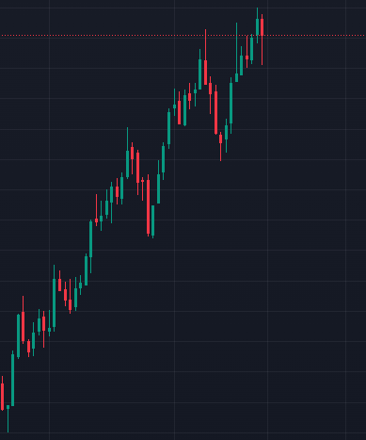
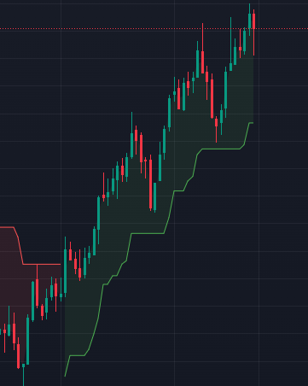
INDICATOR
An indicator refers to a mathematical calculation or statistical tool used to analyze historical price and volume data of a security (such as a stock) or an entire market. The primary purpose of indicators is to help traders and investors make informed decisions about buying, selling, or holding assets.
Example:- Supertrend (Indicator)
Before applying indicator
After applying Indicator
Super
trendline

Slide 6
LITERATURE SURVEY
Year of Publication | Research Paper title and Publication details | Input/Dataset used by them | Approach/Algorithm/ Technique | Drawback | Outcome of their work
2022 | Study of Market Indicators used for Technical Analysis, Srushti Dongrey, Student, MIT School of Management, World Peace University, Pune, Maharashtra, INDIA (2022) | Stock market (Technical indicator) Visualization | Machine learning algorithm | No new indicator has been created done backtesting on existing indicator.
2014 | Research on the Effectiveness of Technical Indicators with the Volume , Gang LI, Jin zhu - Published by Atlantis Press | artificial intelligence or AI algorithm,NIFTY-50 Stock Market Data (2000 - 2021) | Machine learning approach | No mergence of any indicator.
2021 | Survey paper on Technical Indicators of the Stock Markets, Yogesh Vitthal Joshi, Rugved Rahul Shahane 3Prathmesh Chandrakant Pachpute, Journal of Emerging Technologies and Innovative Research | Daily news on stock market prediction dataset | machine learning | No new indicator is developed only backtest previous indicators on bases of daily new of stock market.
2021 | Analysis and Evaluation of Technical Indicators for Prediction of Stock Market, Gananjay Sandeep Thanekar, Prof. Zaheed Shaikh Department of Computer Engineering K. J. Somaiya College of Engineering (JETIR), JETIR December 2021, Volume 8, Issue 12 | Machine learning algorithms. | machine learning-based algorithms. | Only Indicators are explained. (no addition indicator is created)
2022 | A Study of Key Technical Indicators for Effective and Profitable Strategy in Option Trading of Nifty, Dr. Bhaskar V. Patil, Dr. Deepali M. Gala Bharati Vidyapeeth (Deemed to Be University), Institute of Management, | diverse range of text from the internet ,newse,previous stock market analysis | Machine learning | No mergence of any indicator to simplify the technical.

Slide 7
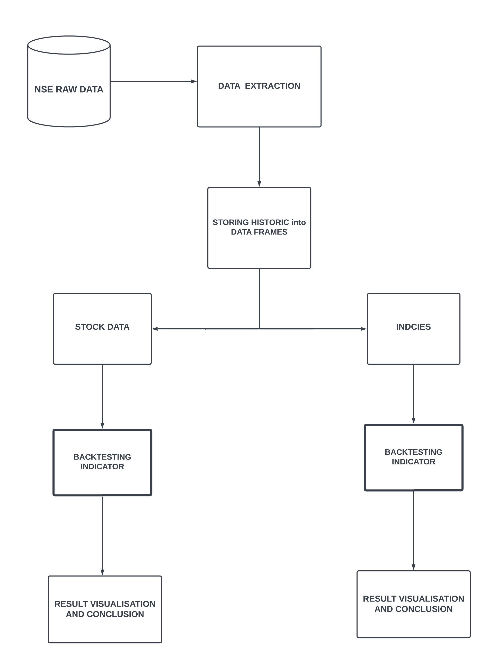
ARCHITECHTURE

Slide 8
DRAWBACKS IN EXISTING APPLICATION
Using multiple indicators can make the analysis process more complex, especially for inexperienced traders. Different indicators may provide conflicting signals or lead to confusion when they generate mixed messages about the market's direction.
Many commonly used indicators are based on past price movements, which means they are lagging indicators. By the time these indicators signal a trend change, the market may have already moved significantly in that direction, resulting in missed opportunities or delayed decision-making.
Some indicators heavily rely on historical price data, which may not accurately represent the current market conditions or future trends. Market dynamics can change rapidly, and past performance does not always guarantee future outcomes.
Different traders may interpret the indicators differently, leading to varying trading decisions. This subjectivity can lead to inconsistency in trading strategies and outcomes.
It is very much beneficial for beginners trader to take exact trade.

Slide 9
APPROACH
In stock predictions, a set of pure technical data, fundamental data, and derived data are used in prediction of future values of stocks. This prediction uses various methods of classification approaches such as neural networks, regression, genetic algorithm, decision tree induction, and
K-Nearest Neighbors (KNN). We are using KNN approach for prediction of future values of stock. It uses similarity metrics to compare a given test entity with the training data set. Each data entity represents a record with n features. In order to predict a class label for unknown record, kNN selects k recodes of training data set that are closest to the unknown records.
The stock prediction problem can be mapped into a similarity based classification. The historical stock data and the test data is mapped into a set of vectors. Each vector represents N dimension for each stock features. Then, a similarity metric such as Euclidean distance is computed to take a decision. In this section, a description of KNN is provided. KNN is considered a lazy learning that does not build a model or function previously, but yields the closest k records of the training data set that have the highest similarity to the test (i.e. query record).Then, a majority vote is performed among the selected k records to determine the class label and then assigned it to the query record.

Slide 10
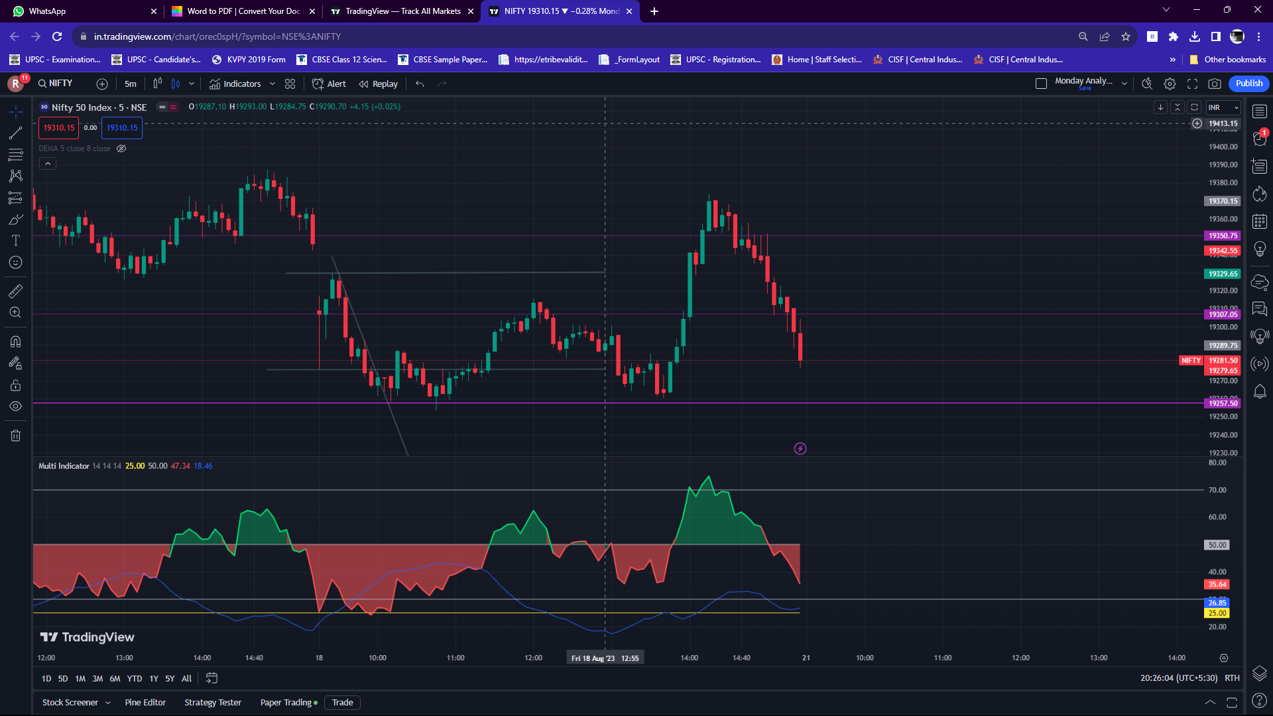
Proposed work

Slide 11
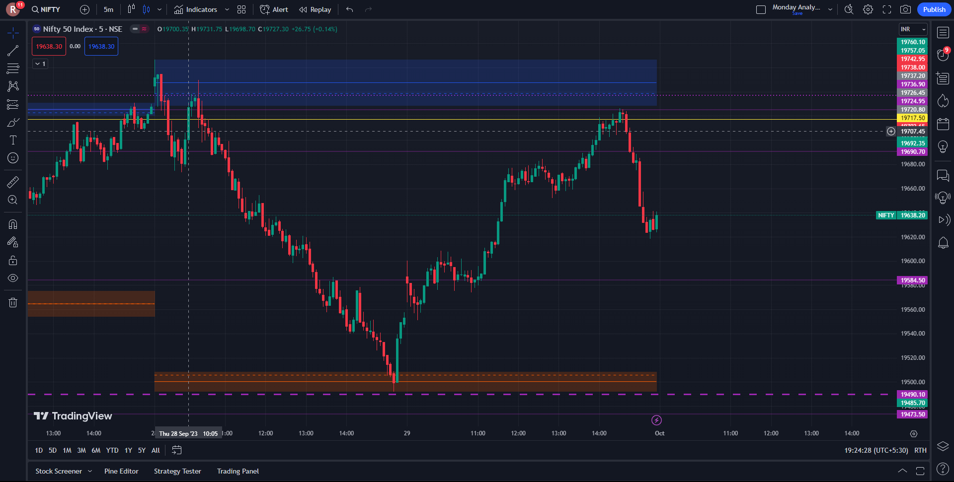

Slide 12
APPLICATION OF PROPOSED WORK
Strength of a trend :- An indicator can also help confirm the strength of a trend. In an uptrend, the Indicator tends to stay above 50, indicating positive momentum. In a downtrend, the indicator tends to stay below 50, indicating negative momentum. Traders can use this information to assess the strength of a trend before making trading decisions.
Beneficial:- Using multi-indicators in stock market analysis can be beneficial as they provide a more comprehensive view of market trends and potential opportunities.
Spotting Divergence:- Divergences between the price chart and the RSI can provide valuable insights.
Trend identification:- Indicator can help identify the direction of the market's trend (upward, downward, or sideways). Traders may use this information to determine whether to take long (buy) or short (sell) positions.
Risk Management: Indicators can aid in setting stop-loss levels and defining risk parameters for trades. This helps traders manage their risk and protect their capital.
Supply and Demand zone: The Supply and Demand Daily indicator displays daily supply and demand areas on the user's chart. These areas are constructed using the market data within a previous daily interval.

Slide 13
REFERANCES
Survey paper on Technical Indicator of the stock market , student, Sinhagd Acadamy of Engineering Kondhwa , pune , Maharashtra, INDIA(2021).
Study of Market Indicators used for Technical Analysis , Srushti Dongrey, Student, MIT School of Management, World Peace University, Pune, Maharashtra, INDIA(2022).
Study of Key Technical Indicators for Effective and Profitable Strategy in Option Trading of Nifty Bhaskar Vijayrao, Patil Deepali Gala(2023).
Technical analysis indicator in stock market using machine learning Yash k. Pardeshi, prof Preeti kale, 12th International Conference on computing communication and networking technologies (ICCCNT) (2021).
Kishinchand Chellaram College of Arts Commerce and Science, Mumbai Mumbai, Maharashtra (2018).

Slide 14
THANK YOU
MUTUAL FUND AND STOCK MARKET INVESTMENTS ARE SUBJECT TO MARKET RISKS, READ ALL SCHEME RELATED DOCUMENTS CAREFULLY..!!

